Slide 1

B⁺ Tree
By Team Booth-Plus Tree
Ashley Lu Couch, Kevin DeMars, Eric Jaroszewski,
Matthew McCaskill, Mohsen Soltani

Slide 2
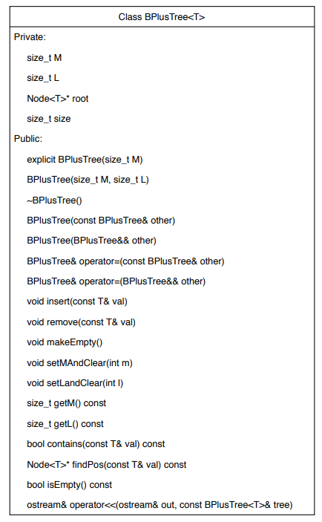
Class overview
BPlusTree
Included operations:
copy and move constructors and assignment operators and destructor
insert, remove, find, size, check empty
operator<< for printing the data
Getters and setters for M and L
BPlusTree is friended to the Renderer class to allow drawing

Slide 3
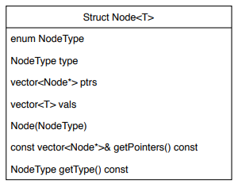
Class overview
Node
Data is stored in a vector which the BPlusTree sizes appropriately.
Pointer(s) to the next node(s) are stored in a vector as well.
To prevent having to create two separate node classes (key and data), we chose instead to use a single Node class and have a flag to distinguish them.
The data vector doubles as both the key and data vector, determined by the type flag.

Slide 4
Graphics behind-the-scenes
Color Rectangle ScreenArea | BitmapImage CharacterGraphics
Arrow | BPlusTreeRenderer

Slide 5
Drawing a b⁺ Tree
Bottom row is drawn first, then the other rows moving up
Each key node is centered with respect to its children
The tree is centered on the screen, horizontally and vertically.
Once the horizontal position of each node on a level is known, the arrows connecting them are drawn.

Slide 6

Insertion/removal algorithm
Insertion
Removal
Find the data node to insert the value
Insert data in correct position in data node
Go back through each node visited on the way to the data node and split if necessary
Find the data node with the value to remove
Remove the data node
If needed, steal from the right sibling if they have excess data
Otherwise, if needed, steal from the left sibling if they have excess data
Otherwise, try merging with the right sibling and remove the value’s key on the way back up
Otherwise, try merging with the left sibling and remove the value’s key on the way back up

Slide 7
Demonstration

